Slide 1


REVIEW - 2
ANOMALY DETECTION IN MEDICAL IMAGES USING TRANSFORMERS-BASED GANS
Presented By Nayan Khemka (20BCE1884) Guide: Professor Premalatha M.

Slide 2
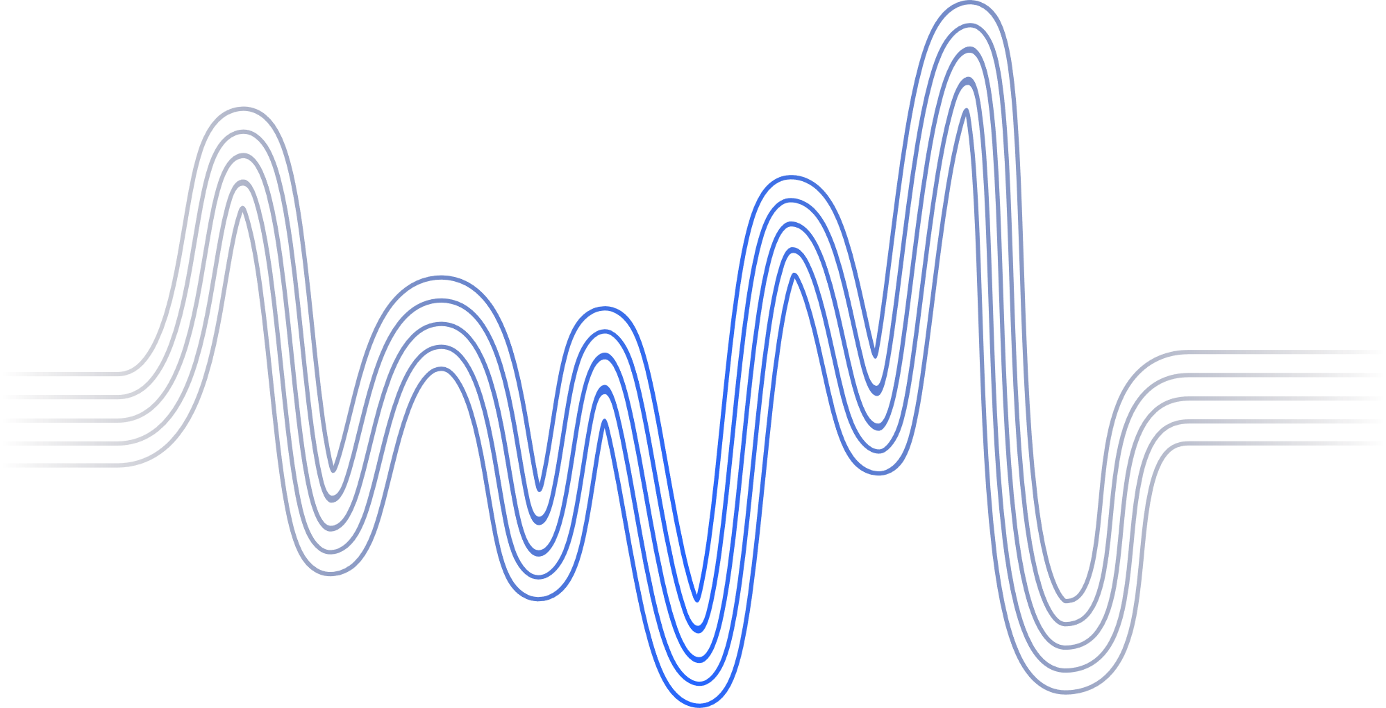
Introduction
Problem Statement
Research Objectives
Proposed System
Implementation
Next Step
Research Paper Status
Guide Approval
Timeline
References
AGENDA

Slide 3
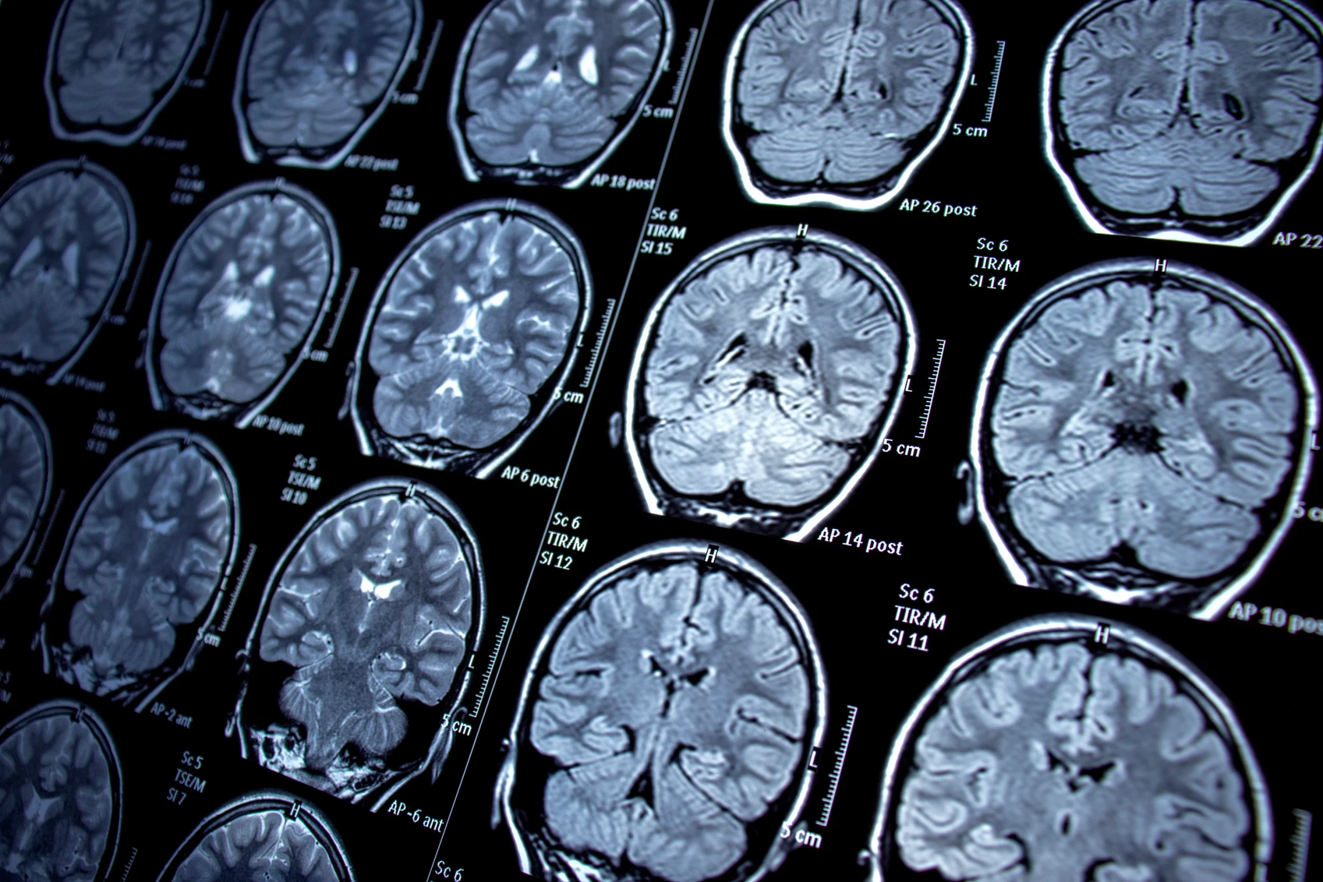

INTRODUCTION
This research proposes a novel approach to anomaly detection in medical images using a combination of transformer-guided Generative Adversarial Networks (GANs)
Back to Agenda
Notes:
We introduce a unique GAN architecture where transformers guide the generation of subtle and diverse anomalies, specifically relevant to the medical domain. Additionally, we employ an attention-based post-processing technique to highlight the generated anomalies, aiding the detection model's focus and interpretability. This approach aims to outperform existing methods by generating more realistic and diverse anomalies, boosting the detection model's performance, and providing interpretable insights into the identified anomalies.

Slide 4
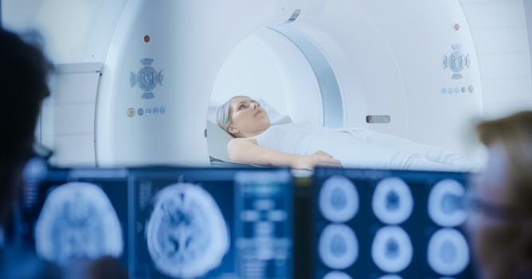

INTRODUCTION
Anomaly detection in medical images, particularly in brain tumor MRI datasets, is a critical task in healthcare. The ViTGAN model represents an innovative approach to enhance anomaly detection in such datasets. Leveraging the Vision Transformer (ViT) architecture, this model integrates advanced features and strategies to improve anomaly detection capabilities. Key enhancements include the incorporation of SIREN layers, SLN layers, Fourier patch embedding, and other techniques to enhance image extraction and anomaly detection. Additionally, the model adopts a double discriminator strategy to effectively address distributional bias during training. This project aims to contribute to the advancement of medical imaging technologies, particularly in the early detection and diagnosis of brain tumors
Back to Agenda

Slide 5
Back to Agenda
LITERATURE SURVEY
Key Discoveries:
GANs & Transformers Exploration:
Potential in medical anomaly detection but require more exploration.
Transformers enhance accuracy in medical image classification.
Combined GANs and transformers show promise but need further study.
Gaps Identified:
Lack of extensive exploration into combined GANs and transformers' potential.
Limited comparative studies to determine optimal anomaly detection approaches.
Need for practical implementations for real-world use.

Slide 6
Back to Agenda
PROBLEM STATEMENT
The accurate and early detection of anomalies in medical images is a critical aspect of healthcare diagnostics. Detecting anomalies in brain tumor MRI datasets poses a significant challenge due to the intricate nature of medical images. Traditional methods may struggle to capture subtle anomalies, necessitating the exploration of advanced techniques. The model seeks to address this challenge by employing the ViTGAN architecture, utilizing transformer-based generator and discriminator networks.
Notes:
The imperative to conduct research on leveraging Transformer-Guided GANs and Attention-based Highlighting for anomaly detection in medical images arises from the critical need to enhance accuracy, interpretability, and versatility in detecting subtle anomalies. Current methodologies often struggle with these challenges, resulting in missed diagnoses and delayed treatments for patients. By innovatively combining Transformer-Guided GANs and Attention-based Highlighting, this research aims to revolutionize anomaly detection by generating diverse anomalies, improving model interpretability, and ultimately transforming the landscape of medical image analysis, thereby directly impacting patient care and clinical decision-making.

Slide 7
RESEARCH OBJECTIVES
Back to Agenda
Develop Transformer-Guided GANs: Create a novel model integrating transformers to guide GANs for realistic medical anomaly generation.
Optimize and Validate: Fine-tune GANs, validate anomaly generation, and optimize model performance.
Implement Attention Mechanism: Introduce attention mechanism for highlighting specific areas in generated anomalies.
Ensure Interpretability: Evaluate interpretability, aligning highlighted areas with medical expectations.
Address Data Challenges: Curate diverse datasets, addressing quality, diversity, and biases.
Enhance Robustness: Implement techniques for robustness to variations in medical images
Notes:
Unique combination: Combining transformer-guided GANs, attention-based highlighting, and contrastive learning specifically for medical image anomaly detection appears novel. Domain-specific optimization: Fine-tuning hyperparameters for the medical domain adds another layer of originality. Focus on subtle and diverse anomalies: Your emphasis on generating realistic and diverse anomalies differentiates your approach from some existing works.

Slide 8
RESEARCH OBJECTIVES
Back to Agenda
Ethical Considerations: Analyze biases, ensuring fairness, and conduct thorough ethical evaluation.
Evaluate Clinical Validity: Assess clinical model performance, involving medical professionals.
Human-in-the-Loop Interaction: Design user-friendly interfaces, integrating human feedback for clinical use.
Optimize for Deployment: Optimize model scalability and compatibility for real-world healthcare deployment.
Conduct Comparative Analysis: Benchmark model against existing anomaly detection methods for medical imaging.
Notes:
Unique combination: Combining transformer-guided GANs, attention-based highlighting, and contrastive learning specifically for medical image anomaly detection appears novel. Domain-specific optimization: Fine-tuning hyperparameters for the medical domain adds another layer of originality. Focus on subtle and diverse anomalies: Your emphasis on generating realistic and diverse anomalies differentiates your approach from some existing works.

Slide 9
Back to Agenda
PROPOSED
SYSTEM
Notes:
Unique combination: Combining transformer-guided GANs, attention-based highlighting, and contrastive learning specifically for medical image anomaly detection appears novel. Domain-specific optimization: Fine-tuning hyperparameters for the medical domain adds another layer of originality. Focus on subtle and diverse anomalies: Your emphasis on generating realistic and diverse anomalies differentiates your approach from some existing works.

Slide 10
Back to Agenda
Introduction
Objective: The primary aim of this project is to develop anomaly detection system for medical images that exhibits robustness, accuracy, and sensitivity in identifying various anomalies.
Importance: Timely identification of anomalies, ranging from subtle to complex deviations in medical images, plays a pivotal role in ensuring appropriate and timely medical interventions. This system seeks to significantly contribute to improving diagnostic precision and treatment planning through automated anomaly detection.
Approach: The proposed approach entails a convergence of cutting-edge technologies including Generative Adversarial Networks (GANs)and transformer architectures. The proposed system leverages the ViTGAN architecture for anomaly detection in brain tumor MRI datasets. ViTGAN combines the power of Vision Transformer (ViT) as the generator and discriminator architecture, enhanced with additional layers for improved performance. It uses 2 different identical discriminators to treat anomalous and normal data separately.

Slide 11
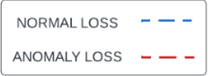
Proposed System Design
Normal Discriminator (ViT)
1 | 1 | 1 | 1
1 | 1 | 1 | 1
1 | 1 | 1 | 1
1 | 1 | 1 | 1
L1 Loss
Normal Adversarial Loss
Patch Loss
Latent vector loss
One matrix (real)
Normal image
Normal reconstruction
Transformer
Encoder
Z’
Z
ResNet50
Feature
Extractor
Transformer
Encoder
Mapping Module
GeneratorViT
Anomaly image
Anomaly reconstruction
ABC Loss
Anomaly Discriminator (ViT)
Anomaly Adversarial Loss
0 | 0 | 0 | 0
0 | 0 | 0 | 0
0 | 0 | 0 | 0
0 | 0 | 0 | 0
Zero matrix (fake)
Notes:
Raw medical images are preprocessed and fed into the Transformer for anomaly feature analysis. The Transformer guides the GAN to generate synthetic images. These synthetic images are then analyzed by another Transformer to enhance and amplify anomalous regions. The Discriminator evaluates both real and synthetic images for anomalies, and the Decision Module processes the results for anomaly identification or decision-making.

Slide 12
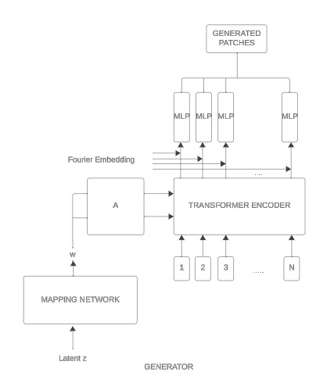
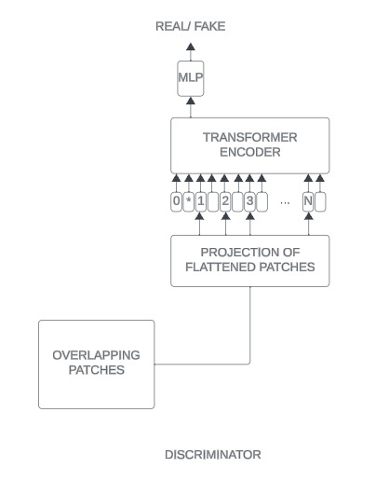
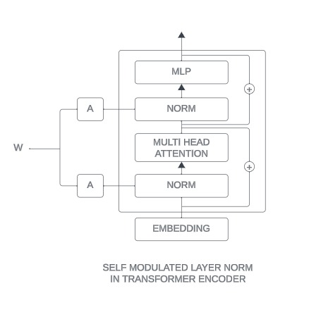
Proposed System Design

Slide 13
Back to Aenda
Modules
1. Generator Module (GeneratorViT):
Responsibility: The Generator Module is responsible for synthesizing or generating synthetic images from random noise or latent vectors. It consists of two main components: a Vision Transformer (ViT) model and a Sinusoidal Representation Network (SIREN) model.
ViT Model: The ViT model is used to encode the input noise or latent vectors into a set of patch embeddings, capturing global image features.
SIREN Model: The SIREN model takes the patch embeddings generated by the ViT model and further processes them to generate image patches. It incorporates Fourier Position Encoding to add spatial information to the generated patches.
2. Discriminator Modules (D_norm and D_anom):
Responsibility: The Discriminator Modules evaluate the authenticity of both generated (synthetic) and real images for both normal and anomaly cases.
D_norm: This discriminator module is responsible for evaluating the authenticity of both real and generated images in normal cases. It distinguishes between real images from the dataset and synthetic images generated by the GeneratorViT.
D_anom: This discriminator module is responsible for evaluating the authenticity of both real and generated images in anomaly cases. It distinguishes between normal images and anomalous images, providing additional supervision for detecting anomalies in the generated images.

Slide 14
Back to Agenda
Modules
3. Transformer Encoder (transformer_encoder):
The transformer encoder block consists of multiple transformer encoder layers. Each layer performs multi-head self-attention and feedforward operations to capture spatial dependencies and extract features from the input data.
4. Anomaly Detection:
Responsibility: The Training Loop orchestrates the entire training process, optimizing the GeneratorViT and Discriminator Modules to improve the quality of the generated images and the discriminative capability of the discriminator modules.
Optimization: The Training Loop uses adversarial training techniques to optimize the GeneratorViT and Discriminator Modules simultaneously. This involves iteratively updating the parameters of the generator and discriminator modules to minimize specific loss functions, such as adversarial losses, reconstruction losses, and additional supervised losses for anomaly detection.
Loss Functions: Various loss functions are utilized during training, including adversarial losses (for both generator and discriminator), reconstruction losses (e.g., L1 loss), and possibly additional supervised losses (e.g., anomaly adversarial loss, normal adversarial loss) to guide the training process towards generating realistic images while effectively detecting anomalies.
Overall, the Generator Module, Discriminator Modules, and Training Loop work together to train the ViTGAN model to generate high-quality images while effectively detecting anomalies in the generated image space.
Notes:
Raw medical images are preprocessed and fed into the Transformer for anomaly feature analysis. The Transformer guides the GAN to generate synthetic images. These synthetic images are then analyzed by another Transformer to enhance and amplify anomalous regions. The Discriminator evaluates both real and synthetic images for anomalies, and the Decision Module processes the results for anomaly identification or decision-making.

Slide 15
Back to Agenda
ViT Generator
The GeneratorViT utilizes TransformerEncoder blocks to capture spatial dependencies and intricate patterns within the input data. A TransformerEncoder block consists of self-attention and feedforward layers.
Self-Attention Mechanism: Self-attention allows the model to weigh the importance of different parts of the input sequence concerning each other. This mechanism enables the model to capture long-range dependencies in the data, crucial for understanding spatial relationships in medical images.
Feedforward Layer: The feedforward layer processes the output from the attention mechanism. It introduces non-linearity and allows the model to learn complex representations from the attention-weighted features.
Layer Normalization and Residual Connections: Layer normalization and residual connections are applied after each sub-layer. These components contribute to stable training and help in overcoming issues like vanishing or exploding gradients.

Slide 16
Back to Agenda
ViT Generator
4. SIREN: The Siren module is a key component of the generator that utilizes sinusoidal activation functions within a feedforward neural network layer. It takes as input the combined hidden states and positional embeddings and is responsible for generating the final output of the generator, which represents the synthesized image. By applying linear transformations to the input data followed by sinusoidal activation functions, Siren effectively transforms the input data into a high-dimensional representation that encapsulates the desired image features, contributing significantly to the image generation process.
5. SLN : Scaled Layer Normalization (SLN) applies layer normalization to the hidden states produced by the transformer encoder. It conditions the normalization process on the intermediate latent vectors (w), allowing for adaptive normalization based on the input data.
6. Positional Encoding: Since transformers do not inherently capture sequential information, positional encoding is added to provide information about the order of tokens in the sequence. Crucial for ensuring the model understands the spatial arrangement of pixels in an image.

Slide 17
Back to Agenda
Discrimator
The use of two discriminators, namely D_norm and D_anom, serves a specific purpose in addressing distributional bias during training.
Discriminator D_norm: Specialized in evaluating images for normal cases. Focusing on normal cases allows the model to differentiate between genuine normal images and anomalies, preventing overfitting to specific types of anomalies.
Discriminator D_anom: Specialized in evaluating images for anomaly cases. Concentrating on anomaly cases ensures that the model can effectively detect deviations from normal patterns.
Rationale for Using Two Discriminators:
Distributional Bias Mitigation: Training a single discriminator might lead to a bias towards classifying images as normal due to the prevalence of normal cases in the dataset. By using two discriminators, each focused on one class, the model is trained to discriminate effectively for both normal and anomaly cases, reducing distributional bias.
Notes:
Raw medical images are preprocessed and fed into the Transformer for anomaly feature analysis. The Transformer guides the GAN to generate synthetic images. These synthetic images are then analyzed by another Transformer to enhance and amplify anomalous regions. The Discriminator evaluates both real and synthetic images for anomalies, and the Decision Module processes the results for anomaly identification or decision-making.

Slide 18
Back to Agenda
Anomaly Detection
The training loop orchestrates the optimization process. The following steps are involved:
1. Discriminator Training: Discriminators are optimized to correctly classify normal and anomaly cases.
Normal Case Training: Discriminator D_norm is trained to correctly classify normal cases and penalize anomalies.
Anomaly Case Training: Discriminator D_anom is trained to correctly classify anomaly cases and penalize normal cases.
2. Generator Training: The generator is trained to minimize reconstruction error for normal cases while maximizing it for anomaly cases.
Notes:
Raw medical images are preprocessed and fed into the Transformer for anomaly feature analysis. The Transformer guides the GAN to generate synthetic images. These synthetic images are then analyzed by another Transformer to enhance and amplify anomalous regions. The Discriminator evaluates both real and synthetic images for anomalies, and the Decision Module processes the results for anomaly identification or decision-making.

Slide 19
Back to Agenda
Anomaly Detection
3. Loss Components:
L1 Reconstruction Error (l1_loss): Measures the pixel-wise difference between generated and real images. This encourages the generator to produce accurate reconstructions.
Patch L1 Loss (patch_loss): Focuses on specific patches in the image, encouraging the generator to pay attention to critical regions. Useful for anomaly detection in medical images.
Latent Vector Loss (latent_loss): Ensures consistency in the latent representations of the generated and real images.
Adversarial Loss (norm_adv_loss and anom_adv_loss): Encourages the generator to produce realistic images by fooling the discriminators.
ABC Loss (abc_loss): Introduced for anomaly cases, penalizing the generator for generating images that are too close to real ones.
Justification for Losses:
The combination of these losses addresses various aspects of image generation, ensuring both realism and anomaly detection capabilities. L1 reconstruction error and patch L1 loss focus on image details, latent vector loss ensures consistent encoding, and adversarial loss promotes realistic image generation. ABC loss specifically addresses anomalies, penalizing overly realistic anomaly images.
Notes:
Raw medical images are preprocessed and fed into the Transformer for anomaly feature analysis. The Transformer guides the GAN to generate synthetic images. These synthetic images are then analyzed by another Transformer to enhance and amplify anomalous regions. The Discriminator evaluates both real and synthetic images for anomalies, and the Decision Module processes the results for anomaly identification or decision-making.

Slide 20
Back to Agenda
Implementation
The generator consists of a Vision Transformer (ViT) model and a SIREN model, with specific modifications such as Self-Modulated Layer Norm (SLN).The SIREN model is used to generate image patches, and it incorporates Fourier Position Encoding. Weight modulation is implemented based on previous work, with adjustments for fully-connected networks using 1D convolution.
The discriminator is mostly a standard Vision Transformer network with various modifications, including DiffAugment, overlapping image patches, and improved spectral normalization.
In the training phase, the model learns to minimize reconstruction error when normal data is entered to the generator, and to maximize reconstruction error when anomaly data is entered. Also, the loss used for maximizing the error with anomaly image input is marked in red color in two ways. In the inference phase, reconstruction error is used to detect anomalies as a criteria standard
Notes:
Raw medical images are preprocessed and fed into the Transformer for anomaly feature analysis. The Transformer guides the GAN to generate synthetic images. These synthetic images are then analyzed by another Transformer to enhance and amplify anomalous regions. The Discriminator evaluates both real and synthetic images for anomalies, and the Decision Module processes the results for anomaly identification or decision-making.

Slide 21
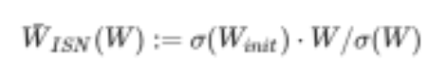
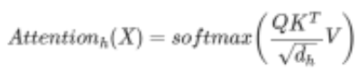
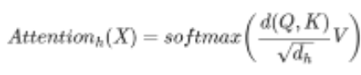
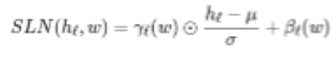
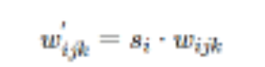

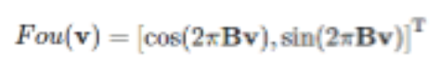
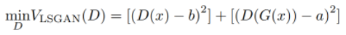
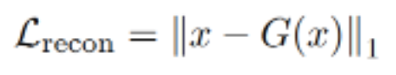
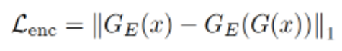
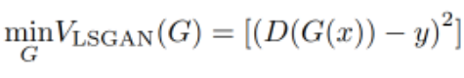
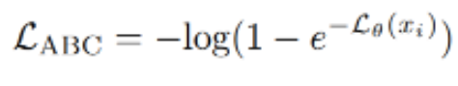
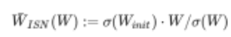


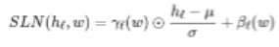
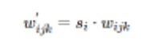

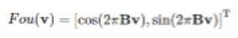
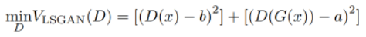
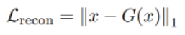
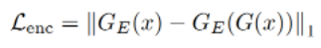
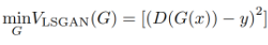
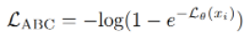
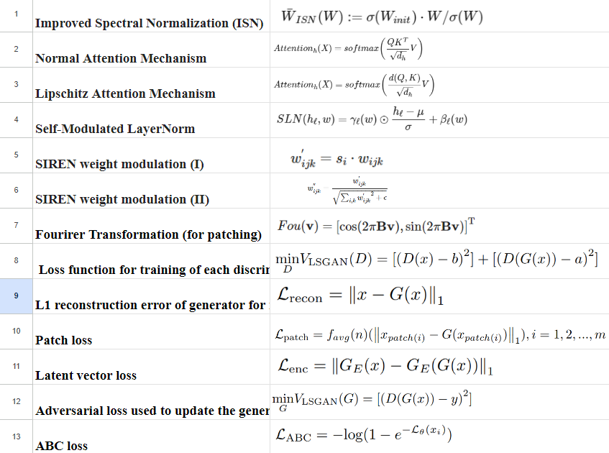
Back to Agenda
Implementation
Formula Used:
Notes:
Raw medical images are preprocessed and fed into the Transformer for anomaly feature analysis. The Transformer guides the GAN to generate synthetic images. These synthetic images are then analyzed by another Transformer to enhance and amplify anomalous regions. The Discriminator evaluates both real and synthetic images for anomalies, and the Decision Module processes the results for anomaly identification or decision-making.

Slide 22
Back to Agenda
Results and Discussions
Random Performance:
An AUROC score of 0.5 suggests that the model is essentially not performing well against the testdata. This could indicate that the model has failed to capture meaningful patterns or features that differentiate between normal and anomalous instances.
Potential Causes:
Inadequate Data Representation: If the features used to represent the data do not capture the relevant characteristics that distinguish between normal and anomalous instances, the model's performance will suffer.
Imbalanced Dataset: Class imbalance, where there are significantly more normal instances than anomalous instances (or vice versa), can lead to biased models that perform poorly on the minority class. This can affect the AUROC score, especially if the model struggles to identify the minority class (anomalies).
Model Complexity: Overly simple or complex models can both lead to poor performance. A model that is too simple may not capture the complexity of the data, while a model that is too complex may overfit to the training data and fail to generalize to unseen instances.
Hyperparameter Tuning: Suboptimal choices of hyperparameters such as learning rate, batch size, or regularization strength can hinder the model's ability to learn meaningful patterns from the data.
Notes:
Raw medical images are preprocessed and fed into the Transformer for anomaly feature analysis. The Transformer guides the GAN to generate synthetic images. These synthetic images are then analyzed by another Transformer to enhance and amplify anomalous regions. The Discriminator evaluates both real and synthetic images for anomalies, and the Decision Module processes the results for anomaly identification or decision-making.

Slide 23
Back to Agenda
Results and Discussions
Insights from Failure:
Despite the disappointing result, the insights that I have gained for working on my model include:
Feature Engineering: Extract more meaningful features from the data that can better distinguish between normal and anomalous instances. This might involve domain-specific knowledge or techniques like dimensionality reduction.
Model Architecture: Experiment with different architectures for the generator and discriminator in your GAN. Adjusting the number of layers, nodes per layer, activation functions, etc., can have a significant impact on the model's ability to learn the data distribution.
Hyperparameter Tuning: Fine-tune the hyperparameters of your GAN and anomaly detection model. Parameters like learning rate, batch size, optimizer choice, and weight initialization can affect model performance.
Notes:
Raw medical images are preprocessed and fed into the Transformer for anomaly feature analysis. The Transformer guides the GAN to generate synthetic images. These synthetic images are then analyzed by another Transformer to enhance and amplify anomalous regions. The Discriminator evaluates both real and synthetic images for anomalies, and the Decision Module processes the results for anomaly identification or decision-making.

Slide 24
Accuracy Enhancement: More Data & Epochs: Train on larger dataset for more epochs to refine the model. Evaluation Refinement: Track accuracy with diverse metrics for holistic assessment. Exploration with Existing Algorithms: Benchmark & Compare: Evaluate against established algorithms (AnoGAN, Ganomaly) on standardized metrics. Strengths & Weaknesses: Analyze results, identify best-suited approaches for your specific task and data.
Next Steps
Notes:
Medical Image Anomaly Detection:
Anomaly Detection in Medical Images with Transformer-Guided GANs and Contrastive Learning (ArXiv preprint, 2023): https://arxiv.org/abs/2001.07847 - This paper closely aligns with your proposed approach, focusing on transformer-guided GANs and contrastive learning for anomaly detection in medical images. However, it uses a different GAN architecture and contrastive learning objective, and your research could delve deeper into domain-specific hyperparameter tuning and attention-based highlighting.
Transformer-guided GANs:
ImageGPT: Generative Pretraining from Pixels (arXiv preprint, 2019): https://proceedings.mlr.press/v119/chen20s.html - This paper introduces the concept of transformer-based image generation. Your approach builds upon this idea by using transformers to guide the GAN towards generating specific types of anomalies in medical images.
Conditional BERT for Contextual Augmentation (EMNLP 2018): https://arxiv.org/abs/1904.06652 - This paper explores using transformers for text-based data augmentation, which can be conceptually adapted for your medical image domain. Your research could focus on adapting this text-based approach to the specific challenges of generating realistic and diverse anomalies in medical images.
Attention-based Anomaly Localization:
Attention-based Anomaly Localization in Medical Images using Transformers (IEEE Transactions on Medical Imaging, 2022): https://ieeexplore.ieee.org/iel7/42/9629464/09469869.pdf - This paper explores attention mechanisms for anomaly highlighting without GANs. Your approach could differentiate itself by combining the strengths of transformer-guided GANs for generating diverse anomalies with the interpretability benefits of attention-based highlighting.
Contrastive Learning:
Contrastive Learning for Anomaly Detection in Medical Images (MICCAI 2022): https://arxiv.org/abs/2103.03423 - This paper focuses on contrastive learning for anomaly detection using real images. Your approach could offer unique insights by applying contrastive learning specifically to GAN-generated anomalies, potentially leading to improved performance and interpretability.

Slide 25
Next-Level Exploration: Implement AnoGAN-ViTGAN: Adapt specific architectures for your task and data characteristics. Evaluation & Ablation: Compare its performance against previous models and explore its internal contribution. Further Considerations: Domain Knowledge: Integrate domain-specific insights for improved modeling and interpretation. Visualization & Interpretability: Use visualization techniques to understand detected anomalies and explain model decisions. Ethical Implications: Proactively address ethical concerns like fairness and bias for responsible deployment.
Next Steps
Notes:
Medical Image Anomaly Detection:
Anomaly Detection in Medical Images with Transformer-Guided GANs and Contrastive Learning (ArXiv preprint, 2023): https://arxiv.org/abs/2001.07847 - This paper closely aligns with your proposed approach, focusing on transformer-guided GANs and contrastive learning for anomaly detection in medical images. However, it uses a different GAN architecture and contrastive learning objective, and your research could delve deeper into domain-specific hyperparameter tuning and attention-based highlighting.
Transformer-guided GANs:
ImageGPT: Generative Pretraining from Pixels (arXiv preprint, 2019): https://proceedings.mlr.press/v119/chen20s.html - This paper introduces the concept of transformer-based image generation. Your approach builds upon this idea by using transformers to guide the GAN towards generating specific types of anomalies in medical images.
Conditional BERT for Contextual Augmentation (EMNLP 2018): https://arxiv.org/abs/1904.06652 - This paper explores using transformers for text-based data augmentation, which can be conceptually adapted for your medical image domain. Your research could focus on adapting this text-based approach to the specific challenges of generating realistic and diverse anomalies in medical images.
Attention-based Anomaly Localization:
Attention-based Anomaly Localization in Medical Images using Transformers (IEEE Transactions on Medical Imaging, 2022): https://ieeexplore.ieee.org/iel7/42/9629464/09469869.pdf - This paper explores attention mechanisms for anomaly highlighting without GANs. Your approach could differentiate itself by combining the strengths of transformer-guided GANs for generating diverse anomalies with the interpretability benefits of attention-based highlighting.
Contrastive Learning:
Contrastive Learning for Anomaly Detection in Medical Images (MICCAI 2022): https://arxiv.org/abs/2103.03423 - This paper focuses on contrastive learning for anomaly detection using real images. Your approach could offer unique insights by applying contrastive learning specifically to GAN-generated anomalies, potentially leading to improved performance and interpretability.

Slide 26
Proposed Timeline
DECEMBER’23
JANUARY’24
FEBRUARY’24
MARCH’24
Literature review, dataset acquisition (MIMIC-CXR, NIH Chest X-ray Dataset), initial experiments.
GAN and attention model design and implementation, initial training and validation on selected datasets.
Model refinement, hyperparameter tuning, comparison with existing methods, preliminary analysis.
Finalization of experiments, results, analysis, paper writing, preparation of presentation and submission to publications by end of March.
Back to Agenda

Slide 27
[1]. Chalapathy, R., & Chawla, S. (2019). Deep learning for anomaly detection: A survey. arXiv preprint arXiv:1901.03407. [2]. Bougaham, A., Delchevalerie, V., Adoui, M. E., & Frénay, B. (2023). Industrial and Medical Anomaly Detection Through Cycle-Consistent Adversarial Networks. arXiv preprint arXiv:2302.05154. [3]. Zhang, L., Dai, Y., Fan, F., & He, C. (2022). Anomaly Detection of GAN Industrial Image Based on Attention Feature Fusion. Sensors, 23(1), 355. [4]. Zhao, H., Li, Y., He, N., Ma, K., Fang, L., Li, H., & Zheng, Y. (2021). Anomaly detection for medical images using self-supervised and translation-consistent features. IEEE Transactions on Medical Imaging, 40(12), 3641-3651. [5]. Shvetsova, N., Bakker, B., Fedulova, I., Schulz, H., & Dylov, D. V. (2021). Anomaly detection in medical imaging with deep perceptual autoencoders. IEEE Access, 9, 118571-118583. [6]. Vucovich, M., Tarcar, A., Rebelo, P., Rahman, A., Nandakumar, D., Redino, C., ... & Bowen, E. (2023, November). Anomaly detection via federated learning. In 2023 33rd International Telecommunication Networks and Applications Conference (pp. 259-266). IEEE. [7]. Miao, J., Tao, H., Xie, H., Sun, J., & Cao, J. (2024). Reconstruction-based anomaly detection for multivariate time series using contrastive generative adversarial networks. Information Processing & Management, 61(1), 103569. [8]. Wang, Z., Wang, X., Tan, K., Han, B., Ding, J., & Liu, Z. (2023). Hyperspectral anomaly detection based on variational background inference and generative adversarial network. Pattern Recognition, 143, 109795.
References

Slide 28
[9]. Mishra, P., Verk, R., Fornasier, D., Piciarelli, C., & Foresti, G. L. (2021, June). VT-ADL: A vision transformer network for image anomaly detection and localization. In 2021 IEEE 30th International Symposium on Industrial Electronics (ISIE) (pp. 01-06). IEEE. [10]. Kim, M., Moon, K. R., & Lee, B. D. (2023). Unsupervised anomaly detection for posteroanterior chest X-rays using multiresolution patch-based self-supervised learning. Scientific Reports, 13(1), 3415. [11]. Li, Q., Yu, Z., Wang, Y., & Zheng, H. (2020). TumorGAN: A multi-modal data augmentation framework for brain tumor segmentation. Sensors, 20(15), 4203. [12]. Iqbal, H., Khalid, U., Chen, C., & Hua, J. (2023, October). Unsupervised anomaly detection in medical images using masked diffusion model. In International Workshop on Machine Learning in Medical Imaging (pp. 372-381). Cham: Springer Nature Switzerland. [13]. Tuli, S., Casale, G., & Jennings, N. R. (2022). Tranad: Deep transformer networks for anomaly detection in multivariate time series data. arXiv preprint arXiv:2201.07284. [14]. Esmaeili, M., Toosi, A., Roshanpoor, A., Changizi, V., Ghazisaeedi, M., Rahmim, A., & Sabokrou, M. (2023). Generative Adversarial Networks for Anomaly Detection in Biomedical Imaging: A Study on Seven Medical Image Datasets. IEEE Access, 11, 17906-17921. [15]. Kumar, A. S., Raja, S., Pritha, N., Raviraj, H., Lincy, R. B., & Rubia, J. J. (2023). An adaptive transformer model for anomaly detection in wireless sensor networks in real-time. Measurement: Sensors, 25, 100625.
References

Slide 29
The status of the research paper is that it is at the stage of initial experimentation and implementation. At this stage, research paper's status reflects the transition from theoretical understanding to practical implementation, aiming to validate the efficacy of the proposed anomaly detection system utilizing GANs, transformers, and attentive highlighting on medical image datasets.
RESEARCH PAPER STATUS

Slide 30

Guide Approval

Slide 31
THANK YOU

